Slide 1
The Output Delivery System
(ODS)
Basics

Slide 2
Credits
Material based on
  Introduction to SAS’s Output Delivery System
    Austin Biostatistics Department Training Meeting
  Amadeus ODS seminar
  SAS ODS documentation
  SAS ODS Web Site
10/05/2001

Slide 3
How can you utilize ODS?
The ODS statement has many options
  TRACE, LISTING, PDF, RTF, HTML, PRINTER, MARKUP, SELECT, EXCLUDE
The FILE statement has an ODS option
  With an _ODS_ option in the associated PUT statement

Slide 4
ODS Benefits
Greater flexibility for controlling procedure output.
  Store any section of output in a data set
  Send output to numerous output formats
  Considerable control over output appearance
  Select which sections of output are stored

Slide 5
Some features of using ODS
Several destinations may be specified per procedure
Procedure output is divided into components called “objects”
Each procedures object has its own unique name by which it is identified
Specific objects may be selected or excluded from output

Slide 6







Two types of ODS destination
Data
  OUTPUT for SAS data sets
  XML for extensible mark-up language (experimental in version 8.2)
Reports
  RTF for Microsoft Word
  PDF for Adobe Acrobat
  HTML for Web browsers
  PRINTER for printers
  LISTING for the output window or plain text file
  New destinations are being developed (e.g. MARKUP)

Slide 7
ODS Syntax 1/2
Open Destination | Close Destination
ods rtf file=”word document.rtf” <options>; | ods rtf close;
ods html file=”web page.htm” <options>; | ods html close;
ods PDF file=”adobe acrobat.PDF” <options>; | ods PDF close;
ods xml file=”XML.xml” <options>; | ods xml close;
ods listing <file=”text.lst” options>; | ods listing close;
ods printer <options>; | ods printer close;
ods output object=data set <options>; | ods output close;

Slide 8
ODS Syntax 2/2
ODS Maintenance | Action
ods select <destination object | all | none>; | Selects objects
ods exclude <destination object | all | none>; | Excludes objects
ods trace <on /options> | off> | Prints object details to log
ods verify <on | off | error>; | Prints or suppresses warnings about style sources
ods path path-argument ; | Specifies locations for reading/writing styles
ods <destination> show ; | Prints selection/exclusion list to log
ods _all_ close; | Simultaneously closes all open ODS destinations

Slide 9
Opening & Closing destinations
ODS destinations must be opened and closed using ODS statements:
    ods destination file=“physical-location”;
    proc procedure;
    run;
    ods destination close;

Slide 10
ODS Trace
Used to gain information about output generated by Procs
  Name of an output object or section
  Label for an output object or section
  Template used for tables
    Frequency table, summary table
  Path to the output object or section

Slide 11
ODS TRACE to find objects
Finding the name of an output object:
ods trace on;
proc univariate data=derdata.efficacy;
class trtcd;
var endpoint;
run;
ods trace off;
View the log file…

Slide 12
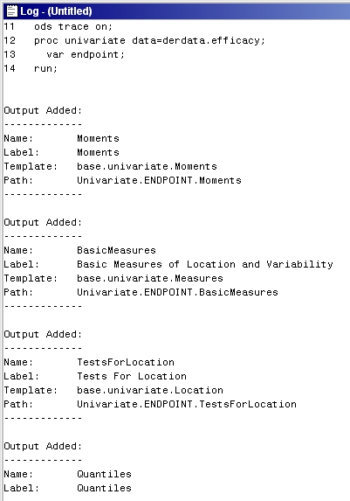
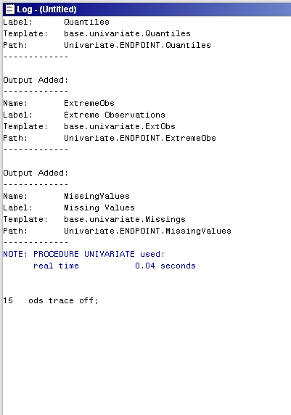
Name of object
Six output
objects

Slide 13
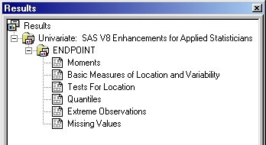
ODS Output in Results Viewer
Each object is shown in the Results window:

Slide 14
ODS Objects
An ODS output object consists of
  Data component
    raw data calculations from procedure, e.g. results of statistical analysis
  Template component
    description of output layout or table Definitions
ODS uses the data & template components to build the output

Slide 15
ODS Objects
Data
Component
Template
Component
OUTPUT
Object
Data Set(s)
Output
Window
RTF File(s)
PDF File(s)
Others…

Slide 16
ODS Select and ODS Exclude
ODS Select and ODS Exclude
  Select/Exclude portions of output
  Works with any format other than the listing.
  For listing use ODS Listing Select or ODS Listing Exclude.
ODS Select ‘SAS Output Specification(s)’;
ODS Exclude ‘SAS Output Specification(s)’;

Slide 17
Overview of select & exclude
Obtaining object names
  ODS TRACE ON;
  View log for list of object names
Select (or exclude) objects
  ODS <destination> SELECT
  selection(s)|ALL|NONE ;
  ODS <destination> EXCLUDE
  selection(s)|ALL|NONE ;
Refer to selection(s) with name, label or (partial) path
View selection in log
  ODS <ODS-destination> SHOW;

Slide 18
Select example
ods select modelanova estimates;
ods show;
proc glm data=derdata.efficacy;
class trtcd;
model endpoint= trtcd / clparm;
estimate 'A vs P' trtcd 1 0 -1;
run;
quit;

Slide 19
ODS Destinations
Listing
Output datasets
Printer
PCL
PS – postscript
ActiveX
JAVA
DISPLAY
CSV
PDF (Portable Document Format)
Rtf (Rich Text Format)
Html (Hypertext Markup Language)
XML (Extensible Markup Language)
Markup
  XML, HTML, CSV, DTDs, CSS, and XSL
  also, PHTML, HTMLCSS, IMODE, WML, WMLOLIST, CSVALL, TROFF, LATEX & DOCBOOK

Slide 20
Listing destination
Listing output is “normal” text output
  Usually it goes to the output window
  Can alternatively write to a file
Statements
  ODS Listing
  ODS Listing Close
  ODS Listing Select
    ODS Listing Select ‘sas output section’;
  ODS Listing Exclude
    ODS Listing Exclude ‘sas output section’;

Slide 21
Listing example
ods listing ;
proc print data=sashelp.shoes ;
run ;
ods listing close ;

Slide 22
Output destination
Use for creating data sets from procedure output
Opening
  Procedure output directly to data set(s)
Option MATCH_ALL creates multiple data sets
  Enforces SAS to create a new data set for multiple objects with the same name (e.g. when using BY group processing)
  Automatic names: name, name1, name2 …
  Use (MATCH_ALL=macro_variable) to create a list of automatic names into a macro variable
Closing:
ods output object(s)
<(MATCH_ALL)>=data set(s);
ods output close;

Slide 23
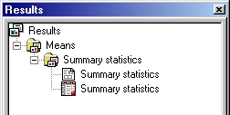
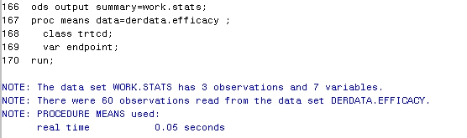
ODS Output example 1
ods output summary=work.stats;
proc means data=derdata.efficacy;
class trtcd;
var endpoint;
run;
ods output close;
One data set for all CLASS levels

Slide 24
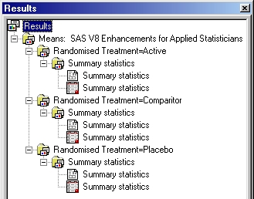
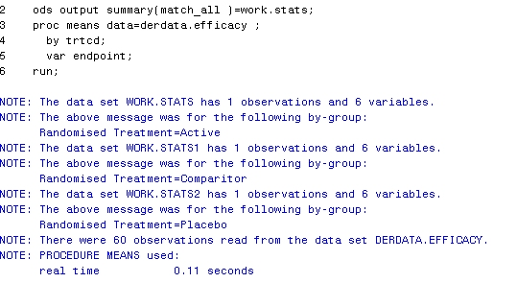
ODS Output example 2
Using the MATCH_ALL option
ods output summary(match_all)=work.stats;
proc means data=derdata.efficacy;
by trtcd;
var endpoint;
run;
ods output close;
Three data sets
created, one
per BY group
PAS4.1: e.g. 4

Slide 25
ODS Output example 3
ods output onewayfreqs
(persist=proc match_all )=work.populations;
proc freq data=derdata.efficacy;
table trtcd ;
where itt=1;
run;
proc freq data=derdata.efficacy;
table trtcd ;
where ee=1;
run;
ods output close;
…Create multiple data sets
Ignoring procedure boundaries…

Slide 26
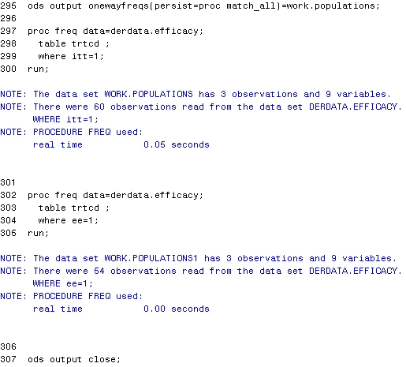
Sequentially numbered
data sets across
procedures

Slide 27
PDF
Not well documented yet.
Available only in SAS Version 8.2
Much nicer than the Printer option when creating PDF output.
Automatically creates bookmarks that are editable to some degree.

Slide 28
PDF: Creating a PDF
ods PDF file=‘filename.PDF’ <options>;
proc procedure
ods PDF close;
Sends procedure output to the PDF file
  In addition to any currently open ODS destinations.

Slide 29
PDF: Controlling Bookmarks
ODS Proclabel
  Allows users to change the procedure names in the bookmarks
Contents_Label option in Proc Template
  Allows users to change contents labels.

Slide 30
ODS RTF
What are the advantages of RTF?
  To the Programmer
    Remove any additional steps to import LST files into Word
    Considerably easier to store and distribute graphics
    Common format for distribution
  To the Reader
    Pleasing to the eye
    Ability to enhance various aspects of the report
    Professional presentation

Slide 31
ODS RTF
Add just two lines of code:
  ods rtf file=‘filename.rtf’ <options>;
  proc procedure
  ods rtf close;
  Sends procedure output to the RTF file, in addition to any currently open ODS destinations.

Slide 32
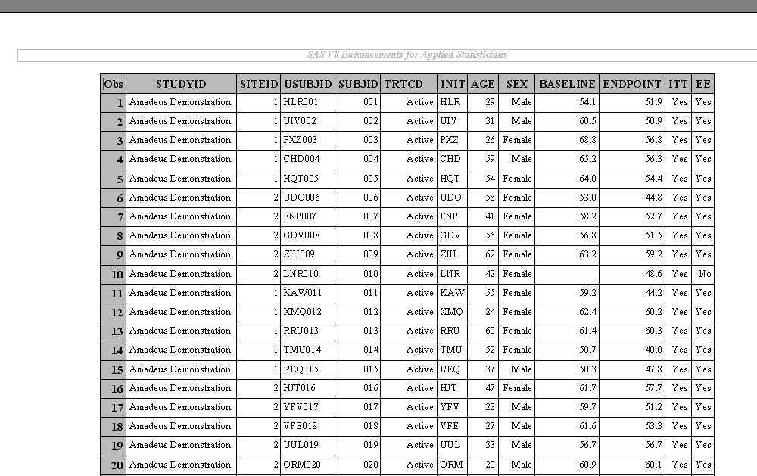
Sending Output to RTF
Titles are stored in document header
Upper left most cell contains a bookmark
Heading rows repeat on each new page
Report stored in a Word Table.
Each datum has its own cell
The above table was created with proc print

Slide 33
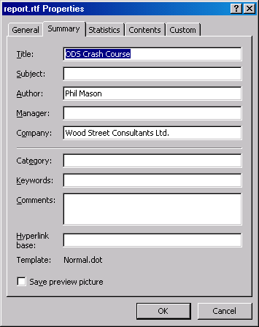
ODS RTF
Setting document properties:
ods rtf file='c:\report.rtf'
author="Phil Mason"
title="ODS Crash Course" ;

Slide 34
ODS RTF
Selecting output objects
  ods rtf file=‘report.rtf’ ;
  ods rtf select modelanova;
  proc glm data=derdata.efficacy;
  class trtcd sex;
  model endpoint = trtcd sex baseline;
  run;
  ods rtf close;
Sends all GLM to the output window, but only ANOVA to the RTF file.

Slide 35
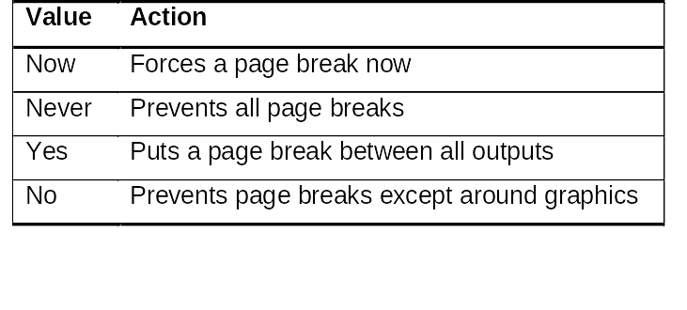
ODS RTF
Page breaks
  Controlled with the ODS STARTPAGE option (applies to RTF & Printer)
  ods startpage= now | never | yes | no;

Slide 36
ODS RTF
Page breaks
  The startpage option can be used either on its own ods statement or with other ods rtf options. For example:
  ods rtf file=‘report.rtf’ startpage=never;
  <procedure>
  <procedure>
  ods rtf startpage=now;
  <procedure>
  ods rtf close;

Slide 37
ODS RTF
Graphics in RTF Files
  Are inserted as pictures (except line plots)
  Can honour true-type windows fonts (JPEG)
  By default are Enhanced Metafile format in SAS 8.2
    Can be changed but in my experience JPEG works best for static images
    ActiveX or Java can be used for interactive graphics
  The picture has a bookmark
Note: we are having some problems with RTFs

Slide 38
ODS HTML
Very well documented
Contains a wide variety of options, allowing users a wider range of control over the structure of their output.
Basic Syntax
ODS HTML file=‘c:\test.html;
SAS Procedure(s);
ODS HTML Close;

Slide 39
ODS HTML
Web pages can be produced as easily as any other format we have considered
  Can create tables of contents
  Links to external webs
  Drillable links to other reports
  Drillable graphics

Slide 40
ODS HTML (continued)
Many options
  file = ‘c:\test.html’;
  body = ‘path (if necessary)\Some_Name.html’;
  path = ‘c:\’;
  contents = ‘path (if nec)\Some_Name.html’;
  newfile = none/proc/output/page/bygroup;
  frame = path (if necessary)\Some_Name.html’;
  style = SAS style/User defined style;

Slide 41
ODS Printer
Sends output directly to a printer
  An understanding of the printer(s) name(s) could be necessary here.
Produces Postscript files
  A standard format to be printed on any printer
Produces PCL (Printer Control Language) output
  Not really useful unless you have an old printer
Produces PDF output
  Three ways to do so.

Slide 42
PDF Output through ODS Printer
First method (if you have no distiller)
  ODS Printer PS File = ‘P\A\T\H\Some_Name.ps’;
  SAS Procedure(s)
  ODS Printer Close;
Second method (if you have a distiller)
  ODS Printer Printer=‘Acrobat Distiller’;
  SAS Procedure(s)
  ODS Printer Close;
Third method (produces same results as ODS PDF)
  ODS Printer PDF File = ‘P\A\T\H\Some_Name.PDF’; SAS Procedure(s)
  ODS Printer Close;

Slide 43
ODS XML
Experimental in 8.2
The syntax is rather basic, not providing much control.
ODS XML File=‘c:\test.xml’;
proc print data=sashelp.shoes ;
run ;
ODS XML Close;

Slide 44
ODS Markup
Experimental in Version 8.2
Will produce the following types of files:
  XML, HTML, CSV, DTDs, CSS, and XSL
  Many more experimental types too
Should be powerful, but will probably require some time to learn.
Basic Markup Syntax
ODS Markup File=‘P\A\T\H\Some_Name.xml’;
SAS Procedure(s)
ODS Markup Close;

Slide 45
Using ODS with Procedures
Procedures support ODS in varying degrees, the following work well
  Proc Print
  Proc Report
  Proc Tabulate
  Proc Freq (with multiway tables)
  Proc Gplot/Gchart

Slide 46
Examples of Procedures using ODS
ODS example 1.sas
ODS example 2.sas

Slide 47
Using ODS with Data Step
Use ODS statement to define destination
Must specify
  ODS on the FILE statement
  _ODS_ on the PUT statement
ods html body='selectvars-body.htm';
data _null_;
set sashelp.class ;
file print ods ;
put _ods_ ;
run ;
ods html close;

Slide 48
Selecting variables with ODS in the data step
ods html body='selectvars-body.htm';
title 'Class information';
data _null_;
length comment $ 20 ;
set sashelp.class ;
file print ods=(variables=(name sex age comment));
put _ods_ @ ;
if sex='F' then
put @4 'girl' ;
else
put ;
run ;
ods html close;

Slide 49
Using Styles to control appearance
By default SAS uses a built in “style”
What are Styles?
  Styles control the fonts, size of fonts, colours, column widths, border drawing and then some! There are almost 90 attributes which can be controlled
  There are several ways of applying style to our output…

Slide 50
Applying ODS styles
On the ODS statement:
ods destination file=‘filename.ext’ style=name ;
where name is a supplied or user defined style name.

Slide 51
Applying styles in Procs
proc report data=derdata.efficacy nofs
style(report)=[rules=groups
frame=hsides]
style(column)=[font=('Arial',8pt)
cellwidth=2cm]
style(header)={font=('Arial',8pt)
  background=white};
run;

Slide 52
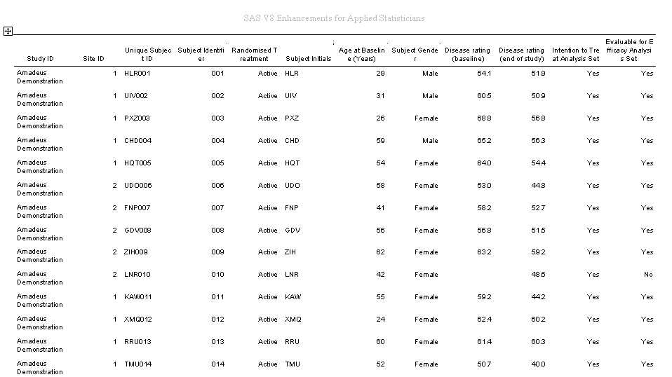
Header area of proc report
A column area of proc report
Report area of proc report

Slide 53
Defining a Generic Appearance for a Project
We could use style statements at procedure level…
But defining a style with Proc TEMPLATE is more efficient and easier to apply change
  Can be stored in a project library
  Access can be set in the project autoexec
Control paper size with:
    options papersize=A4;
Depends on installed printer!

Slide 54
Notes on supplied Styles
SAS supplies 17 built in styles
Some do, and some do not allow the user to alter page margins for your output
  e.g. the default style for RTF, ‘RTF’, does not!
I recommended you define your own style with proc template for your projects

Slide 55
List of supplied styles
Look at RESULTS window
Right click on results
Select templates
Expand SASHELP.TMPLMST
Select styles

Slide 56
Comparing 2 styles output
Try this…
ods html body='C:\body.html';
proc freq data=sashelp.shoes ;
table region*product ;
run ;
ods html close ;
And then rerun with this as the 1st line …
ods html body='C:\body.html' style=styles.statdoc ;

Slide 57
How to define your own style
Determine which fonts and font sizes you wish to use
Decide on page sizes, margins and other settings such as cell padding and border drawing (remember ICH)
Find a similar looking SAS supplied style, copy it, alter it, store it and apply it.

Slide 58
Partial Example of Proc Template
proc template ;
define style custom / store=project.styles;
parent = styles.printer;
Name of our style definition
Project library (libref)
Name of SAS Item Store

Slide 59
Applying a Generic Appearance to a Project
ods path project.styles(read) sashelp.tmplmst(read);
ods path project.styles(update);
Allows multiple users simultaneously
Default library of SAS styles
Necessary for amending styles

Slide 60
Applying the Generic Appearance of a Project
ods rtf file=‘listing.rtf’ style=custom;
  proc report data=sashelp.class nofs
  <style={attribute=setting}>;
  run;
ods rtf close;
Requests the style “Custom”
Styles set here override generic styles

Slide 61
The Template Procedure
Allows users to control the appearance of their output.
Many different kinds of templates
  Table, Style, Column, Header, Footer, Tree, Tagset
Template is too complex to cover in this course
  Will be covered in advanced reporting course

Slide 62
Examining supplied templates
Go to templates window via RESULTS window
You can see default template defined for each type of output
Can also see tagsets defined for special types of output
These provide a useful starting point for producing your own templates

Slide 63
Examining a style
Use the following code
Proc template ;
source styles.default ;
Run ;

Slide 64
Advanced ODS course
This will be delivered soon
It will cover
  Modifying a supplied template
  Creating templates from scratch

Slide 65
Further information
SAS’s ODS page
http://www.sas.com/rnd/base/index-ods-resources.html
SAS Online Documentation
SUGI Papers online http://www.sas.com/usergroups/sugi/proceedings/index.html
Books
  The Complete Guide to the Output Delivery System, Version 8
  Output delivery system: The basics
    By Lauren E. Haworth

Slide 66
Questions on ODS?

